Slide 1
Design document project title: Obstacle Avoidance Robot V1.0 Design
Represented by: Hazem Ashraf

Slide 2
Table of contents
1. Project introduction
2. High Level Design
2.1 Layered architecture
2.2 Modules Description
2.3 Application Design
2.4 Driver’s documentation
3. Low-level Design
3.1 module function flowchart
3.2 Pre-compiling configurations for each module
3.3 Linking configurations for each module

Slide 3
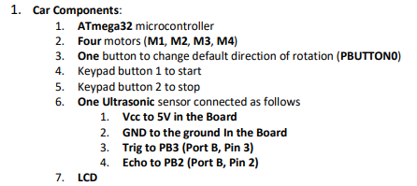
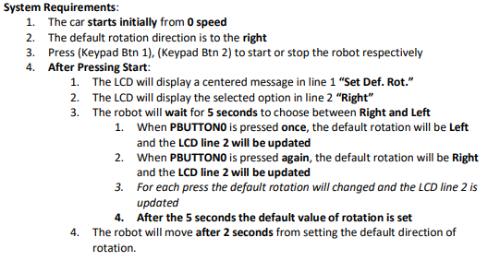
Project introduction
Description
Suppose you have a four-diving wheel robot, you are required to design the system so that the robot avoid any object in front.
System Requirement Specifications

Slide 4
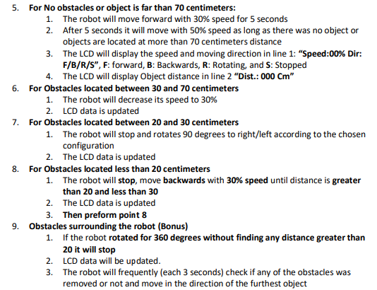
Project introduction

Slide 5
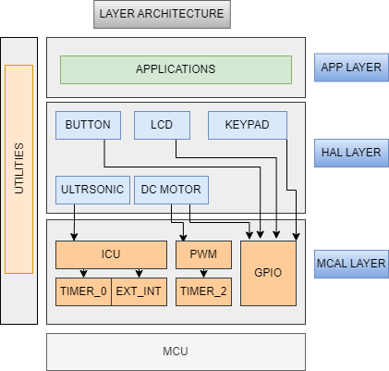
High Level Design
Layered architecture
Modules Description
MCAL modules
GPIO
Using GPIO for initialize button ,keypad ,lcd and dc motor
PWM
Use PWM to generate PWM signal for motor speed control
ICU
Use ICU with ULTRASONIC sensor for calculating distance by calculate time period of the return signal
Timer_0
Use Timer with ICU to calculate time period of the signal
EXT_INT
Use EXT_INT with ICU to configure the edge detection of the signal
TIMER_2
Use Timer_2 to implement PWM using software implementation

Slide 6
High Level Design
Modules Description
HAL modules
ULTRASONIC
Use ultrasonic sensor for get distance of around obstacles
BUTTON
Use push button for determine rotation direction
LCD
Use LCD to display states of the car speed , direction and distance
KEYPAD
Use Keypad button 1 and 2 for start and stop car
DC motor
Use DC motor for control car movement direction and speed
APP Layer
Contain software algorithm for avoiding obstacles

Slide 7
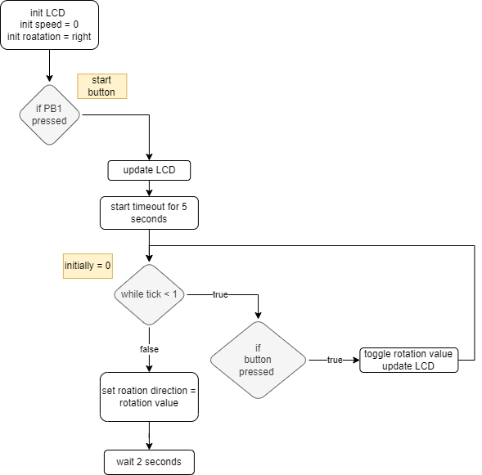
Application design
Initialization workflow
We start application by initialize the external hardware and find the rotation direction to be left / right

Slide 8
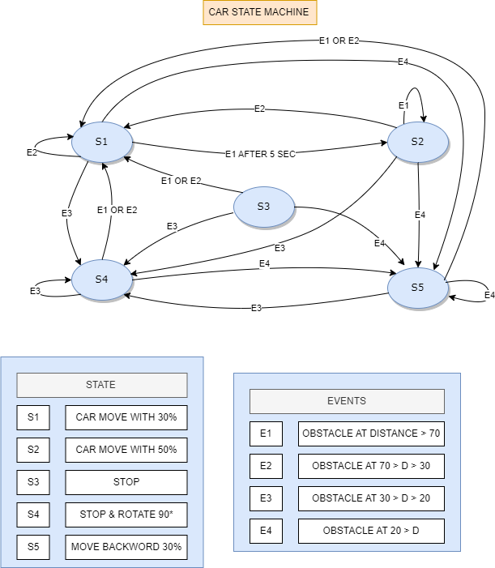
Application design
State machine diagram
By assuming the system is consist of states and events we can implement the moving car cases according to this stateMachine flow

Slide 9
Application design
Application variables
Define enum for car state
{S1,S2,S3,S4,S5,MAX_STATE}
Define enum for events
{E1,E2,E3,E4}
Define enum for car directions
{ FW , BW , ROTATE , STOP }
Define enum for rotation direction
{ Right , Left }
System variables
Uint8 g_currentstate
Uint8 speed
Enum direction
Enum rotation
Enum event
En_event Readevent (void)
Use to read the distance and return the corresponding event
Void stateMachine(En_event)
Use to run state machine workflow and determine new state
Void Car_init (void)
Used to initialize rotation direction and initial speed
Void motor_control (motor ID1, motor ID2, motor ID3, motor ID4, direction , speed)
Used for control car movement
Void LCD_display (speed,direction,distance)
Used to display and update car informations on LCD
Application APIs

Slide 10
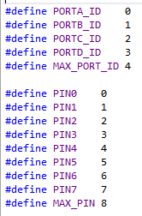
Drivers Documentation Project Modules APIs
GPIO module APIs
/*============= TYPE DEFINITION =============*/
typedef enum{
PIN_INPUT,PIN_OUTPUT
}EN_PIN_DIRECTION;
typedef enum
{
PORT_INPUT,PORT_OUTPUT=0xFF
}EN_PORT_DIRECTION;
typedef enum{
Low,High
}EN_PIN_VALUE;
typedef enum{
LOW,HIGH=0xFF
}EN_PORT_VALUE;
typedef enum{
FAILED,SUCCESS
}EN_STATE;
/*============= FUNCTION PROTOTYPE=============*/
EN_STATE GPIO_setPinDirection(uint8 port_num, uint8 pin_num, EN_PIN_DIRECTION direction);
Description:
Used to set specific pin direction as input or output pin
Port_num: determine port in which pin is connected, you have to use port_ID which defined as MACROS
Pin_num: determine pin number , you have to use PIN which
defined as MACROS
Direction: used to determine direction of the pin, you have to use
Enum EN_PIN_DIRECTION (PIN_INPUT,PIN_OUTPUT)
Return : function check for the range of port_ID and PIN number
Return SUCCESS if true and FAILED if out of range
EN_STATE GPIO_checkstate(uint8 port_num,uint8 pin_num);
Description:
Used to check for the range of port_ID and pin range
Port_num: determine port in which pin is connected, you have to use port_ID which defined as MACROS
Pin_num: determine pin number , you have to use PIN which defined as MACROS
Return : function check for the range of port_ID Return SUCCESS if true and FAILED if out of range

Slide 11
Drivers Documentation Project Modules APIs
GPIO module APIs
EN_STATE GPIO_writePin(uint8 port_num, uint8 pin_num, EN_PIN_VALUE value);
Description:
used to write high or low to specific pin
Port_num: determine port in which pin is connected, you have to use port_ID which defined as MACROS
Pin_num: determine pin number , you have to use PIN which
defined as MACROS
Value: used to determine direction of the pin, you have to use
Enum EN_PIN_VALUE (Low,High)
Return : function check for the range of port_ID and PIN number
Return SUCCESS if true and FAILED if out of range
EN_STATE GPIO_readPin(uint8 port_num, uint8 pin_num,uint8* value);
Description:
used to read specific pin value
Port_num: determine port in which pin is connected, you have to use port_ID which defined as MACROS
Pin_num: determine pin number , you have to use PIN which defined as MACROS
Value: the address to variable of the return reading (High, Low)
Return : function check for the range of port_ID and PIN number Return SUCCESS if true and FAILED if out of range
EN_STATE GPIO_togglePin(uint8 port_num, uint8 pin_num);
Description:
used to toggle the output state of the pin
Port_num: determine port in which pin is connected, you have to use port_ID which defined as MACROS
Pin_num: determine pin number , you have to use PIN which defined as MACROS
Return : function check for the range of port_ID and PIN number Return SUCCESS if true and FAILED if out of range
EN_STATE GPIO_setPortDirection(uint8 port_num, EN_PORT_DIRECTION direction);
Description:
used to determine port direction
Port_num: determine port ,you have to use port_ID which defined as MACROS
Direction: used to determine direction of the pin, you have to use
Enum EN_PORT_DIRECTION (PORT_INPUT,PORT_OUTPUT)
Return : function check for the range of port_ID Return SUCCESS if true and FAILED if out of range

Slide 12
Drivers Documentation Project Modules APIs
GPIO module APIs
EN_STATE GPIO_writePort(uint8 port_num, uint8 value);
Description:
used to write high/low to specific port
Port_num: determine port ,you have to use port_ID which defined as MACROS
Value: used to determine direction of the port, you have to use Enum EN_PORT_VALUE [LOW,HIGH]
Return : function check for the range of port_ID Return SUCCESS if true and FAILED if out of range
EN_STATE GPIO_readPort(uint8 port_num,uint8* value);
Description:
used to read the value of specific port
Port_num: determine port ,you have to use port_ID which defined as MACROS
Value: the address to variable of the return reading (High, Low)
Return : function check for the range of port_ID Return SUCCESS if true and FAILED if out of range

Slide 13
Drivers Documentation Project Modules APIs
Timer0_delay module APIs (TIMER_0.h)
/*============= TYPE DEFINITION =============*/
typedef struct{
float delay;
uint16 prescaler;
uint8 init_value;
float NO_OF_OV;
}ST_timer0_config;
Description:
the structure is used to implement delay object, to define delay variable:
Timer0_delay module APIs (TIMER_0.h)
/*============= FUNCTION PROTOTYPE =============*/
void Timer0_Delay(float delay);
Description:
used to apply delay using polling technique
it convert number of overflows to integer number to implement the required delay correctly
example: if number of overflows=3.8
mean perform 3 overflows and calculate the remaining time to complete the delay
void Timer0_event(uint16 delay,void(*g_ptr)(void));
Description:
used to apply time out delay and run function if a period of time has passed
Delay: delay time
g_ptr: pointer to function which is called when time has passed

Slide 14
Drivers Documentation Project Modules APIs
EXT-interrupt module APIs
/*============= TYPE DEFINITION =============*/
typedef enum{
EN_INT0,EN_INT1,EN_INT2
}EN_INT_source;
typedef enum{
LOW_LEVEL,ANY_CHANGE,FALLING,RISING
}EN_INT_TRIGGER;
typedef enum{
INT_FAILED,INT_SUCCESS
}EN_INT_error;
typedef struct{
EN_INT_source source;
EN_INT_TRIGGER trigger;
}ST_INT_Config;
#define INT0_pin 2 //PD2
#define INT1_pin 3 //PD3
#define INT2_pin 3 //PB2
/*============= FUNCTION PROTOTYPE =============*/
EN_INT_error INT_init(ST_INT_Config* Int_config)
Description
INT_init: used to initialize the interrupt by:
disable global interrupt
enable external interrupt source and set pin to input
set external interrupt trigger signal type
enable global interrupt
Function parameters
Int_config: pointer to structure of ST_INT_Config
Return : FAILED if passing parameters is not correct, SUCCESS if the passing parameters is correct
void INT0_setCallBack(void(*a_ptr)(void));
Description:
INT0_setCallBack:used to set call back function for external INT_0
void INT1_setCallBack(void(*a_ptr)(void));
Description:
INT1_setCallBack:used to set call back function for external INT_1
void INT2_setCallBack(void(*a_ptr)(void));
Description:
INT2_setCallBack:used to set call back function for external INT_2
void INT_Deinit(ST_INT_Config* Int_config);
Description:
INT_init: used to initialize the interrupt by:
Disable specific external interrupt source

Slide 15
Drivers Documentation Project Modules APIs
ICU module APIs
/*============= TYPE DEFINITION =============*/
typedef enum
{
NO_CLOCK,F_CPU_CLOCK,F_CPU_8,F_CPU_64,F_CPU_256,F_CPU_1024
}Icu_Clock;
typedef enum
{
FALLING,RISING
}Icu_EdgeType;
typedef struct
{
Icu_Clock clock;
Icu_EdgeType edge;
}Icu_ConfigType;
/*============= FUNCTION PROTOTYPE =============*/
void Icu_init(Icu_ConfigType * Config_Ptr);
Description : Function to initialize the ICU driver
1. Set the required clock.
2. Set the required edge detection.
3. Enable the External Interrupt.
4. Initialize Timer1 Registers
void Icu_setCallBack(void(*a_ptr)(void));
Description: Function to set the Call Back function address.
void Icu_setEdgeDetectionType(Icu_EdgeType edgeType);
Description: Function to set the required edge detection.
uint16 Icu_getInputCaptureValue(void);
Description: Function to get the Timer1 Value when the external interrupt catch edge The value stored at timer register saved to a variable
void Icu_clearTimerValue(void);
Description: Function to clear the Timer1 Value to start count from ZERO
void Icu_DeInit(void);
Description: Function to disable the Timer1 and External Interrupt to stop the ICU Driver

Slide 16
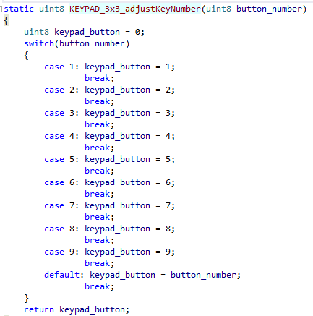
Drivers Documentation Project Modules APIs
Keypad driver APIs
This is a keypad static configuration, before using driver you have to configure the macros according to keypad specifications and hardware connections
/*====Keypad configurations for number of rows and columns==== */
#define KEYPAD_NUM_COLS 3
#define KEYPAD_NUM_ROWS 3
/*============= Keypad Port Configurations =============*/
#define KEYPAD_PORT_ID PORTB_ID
#define KEYPAD_FIRST_ROW_PIN_ID PIN3
#define KEYPAD_FIRST_COLUMN_PIN_ID PIN0
/*=========== Keypad button logic configurations =========== */
#define KEYPAD_BUTTON_PRESSED LOGIC_LOW
/*============= FUNCTION PROTOTYPE=============*/
uint8 KEYPAD_getPressedKey(void);
Description:
Used to get the pressed key from the keypad
static uint8 KEYPAD_3x3_adjustKeyNumber(uint8 button_number);
Description:
Before code compilation, modify the function to determine keypad map for each key location

Slide 17
Drivers Documentation Project Modules APIs
LCD driver APIs
/*============= MACRO DEFINITION =============*/
/* LCD HW Ports and Pins Ids */
#define LCD_RS_PORT_ID PORTD_ID
#define LCD_RS_PIN_ID PIN4_ID
#define LCD_RW_PORT_ID PORTD_ID
#define LCD_RW_PIN_ID PIN5_ID
#define LCD_E_PORT_ID PORTD_ID
#define LCD_E_PIN_ID PIN6_ID
#define LCD_DATA_PORT_ID PORTC_ID
/* LCD Commands */
#define LCD_CLEAR_COMMAND 0x01
#define LCD_GO_TO_HOME 0x02
#define LCD_TWO_LINES_EIGHT_BITS_MODE 0x38
#define LCD_TWO_LINES_FOUR_BITS_MODE 0x28
#define LCD_CURSOR_OFF 0x0C
#define LCD_CURSOR_ON 0x0E
#define LCD_SET_CURSOR_LOCATION 0x80
/*============= FUNCTION PROTOTYPE=============*/
void LCD_init(void);
Description :Initialize the LCD:
Setup the LCD pins directions by use the GPIO driver.
Setup the LCD Data Mode 4-bits or 8-bits.
void LCD_sendCommand(uint8 command);
Description :Send the required command to the screen
void LCD_displayCharacter(uint8 data);
Description :Display the required character on the screen
void LCD_displayString(const char *Str);
Description :Display the required string on the screen
void LCD_moveCursor(uint8 row,uint8 col);
Description :Move the cursor to a specified row and column index on the screen
void LCD_displayStringRowColumn(uint8 row,uint8 col,const char *Str);
Description :Display the required string in a specified row and column index on the screen
void LCD_intgerToString(int data);
Description :Display the required decimal value on the screen

Slide 18
Drivers Documentation Project Modules APIs
Ultrasonic driver APIs
void Ultrasonic_init(void);
Description : Function to initialize the ultrasonic driver
1-initialize ICU driver
2-set callback function
3-setup trigger pin direction as output
void Ultrasonic_Trigger(void)
Description : function to send trigger signal
void Ultrasonic_edgeProcessing(void)
Description : function to count number of edges and to calculate time of generated pulse
uint16 Ultrasonic_readDistance(void);
Description : function to read distance of from the sensor

Slide 19
Drivers Documentation Project Modules APIs
BUTTON module APIs
/*============= TYPE DEFINITION =============*/
typedef enum{
disable,enable
}EN_internal_pullup;
/*============= FUNCTION PROTOTYPE =============*/
EN_STATE Button_init(uint8 pin,EN_internal_pullup state);
Description
Button_init: used to initialize BUTTON direction and set internal pullup resistor
function parameters
pin: pin number to be set
State: to disable/enable internal pullup resistor
Return success pin number is in the range, FAILED if pin number out of the range
uint8 Button_Read(uint8 pin);
Description
Button_Read: used to read button state high/low
function parameters
pin: pin number to read
Return button state high / low

Slide 20
Drivers Documentation Project Modules APIs
DC motor module APIs
/*============= TYPE DEFINITION =============*/
typedef struct{
uint8 port_ID;
uint8 PIN_ID;
}ST_PIN;
typedef struct{
ST_PIN pin1;
ST_PIN pin2;
}ST_DCmotor_configtype;
typedef enum{
CW,ACW,stop
}EN_DCMotor_state;
/*============= FUNCTION PROTOTYPE =============*/
EN_STATE DCmotor_init(ST_DCmotor_configtype *motor);
Description:
Used to initialize motor direction and set to low as initial value
Enable PWM module
Return success pin number is in the range, FAILED if pin number out of the range
void DCmotor_start(ST_DCmotor_configtype *motor,EN_DCMotor_state State,uint8 speed);
Description:
Used to control motor direction and speed using PWM
void DCmotor_stop(ST_DCmotor_configtype *motor);
Description:
Used to stop the motor by disable PWM module and stop motor rotating

Slide 21
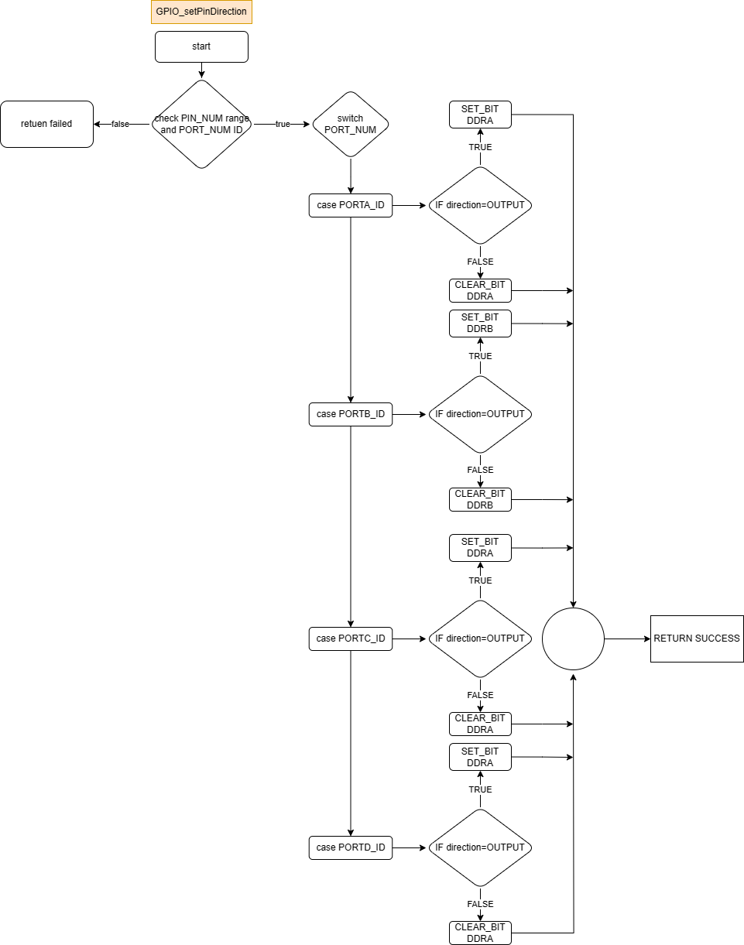
GPIO APIs flowchart
EN_STATE GPIO_setPinDirection(uint8 port_num, uint8 pin_num, EN_PIN_DIRECTION direction);

Slide 22
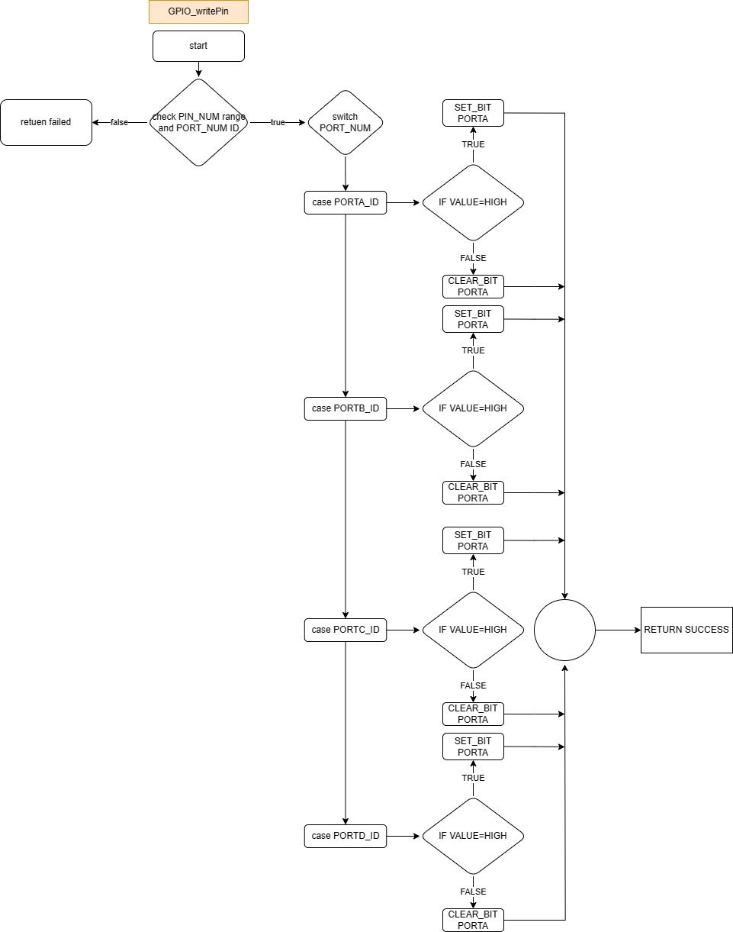
GPIO APIs flowchart
EN_STATE GPIO_writePin(uint8 port_num, uint8 pin_num, EN_PIN_VALUE value);

Slide 23
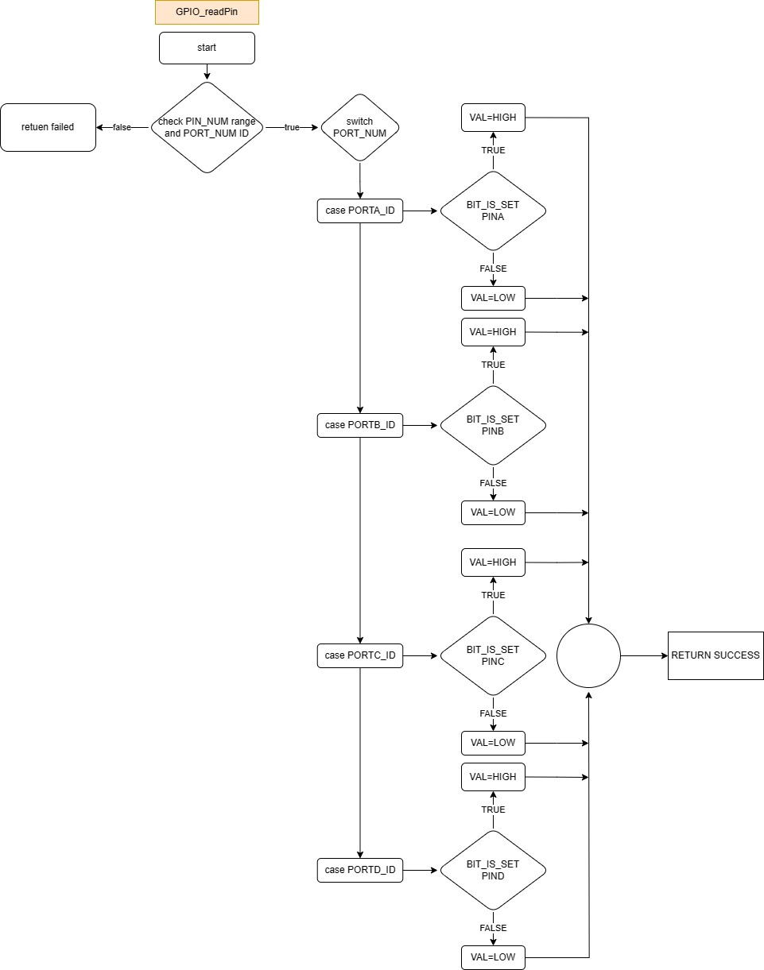
GPIO APIs flowchart
EN_STATE GPIO_readPin(uint8 port_num, uint8 pin_num,uint8* value);

Slide 24
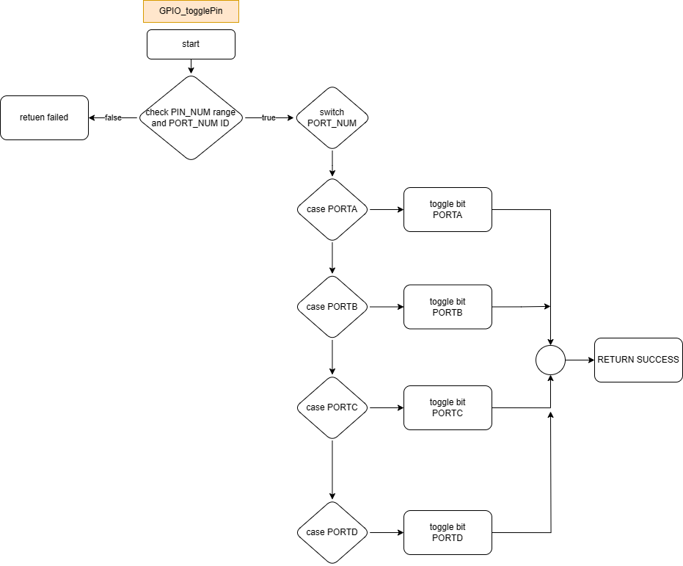
GPIO APIs flowchart
EN_STATE GPIO_togglePin(uint8 port_num, uint8 pin_num);

Slide 25
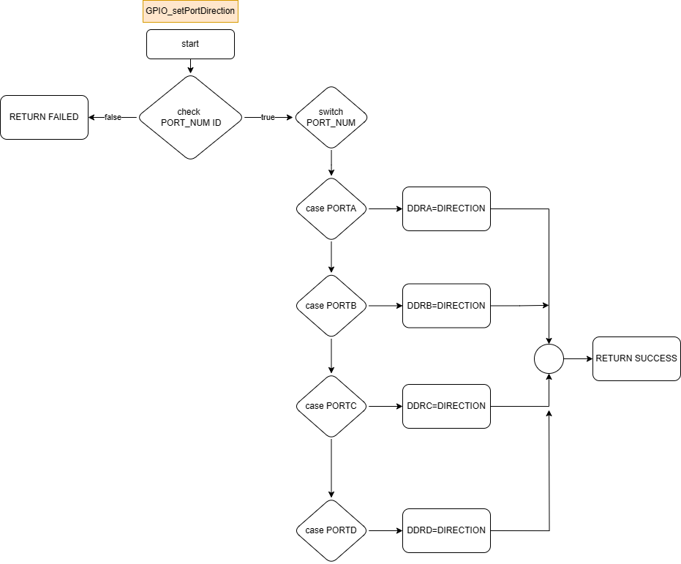
GPIO APIs flowchart
EN_STATE GPIO_setPortDirection(uint8 port_num, EN_PORT_DIRECTION direction);

Slide 26

GPIO APIs flowchart
EN_STATE GPIO_writePort(uint8 port_num, uint8 value);

Slide 27

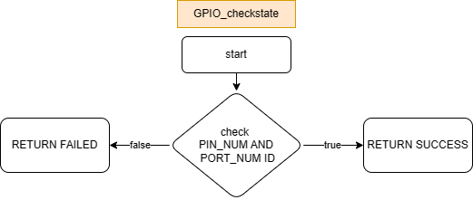
GPIO APIs flowchart
EN_STATE GPIO_readPort(uint8 port_num,uint8* value);
EN_STATE GPIO_checkstate(uint8 port_num,uint8 pin_num);

Slide 28
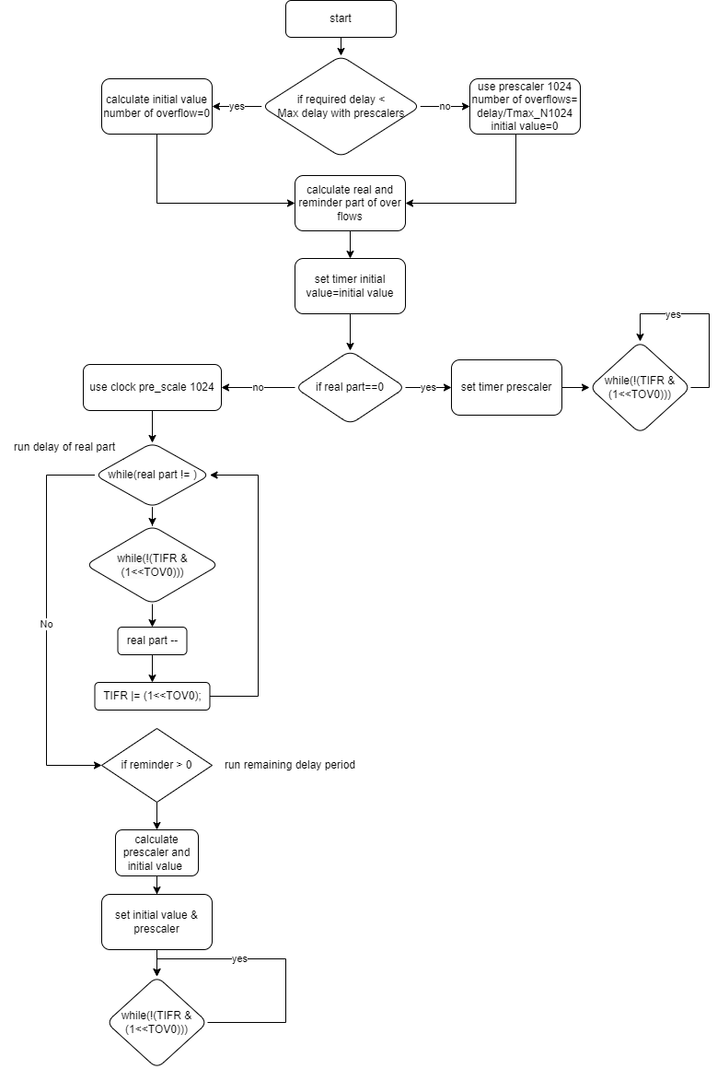
Timer0 APIs flowchart
void Timer0_Delay(float delay);

Slide 29
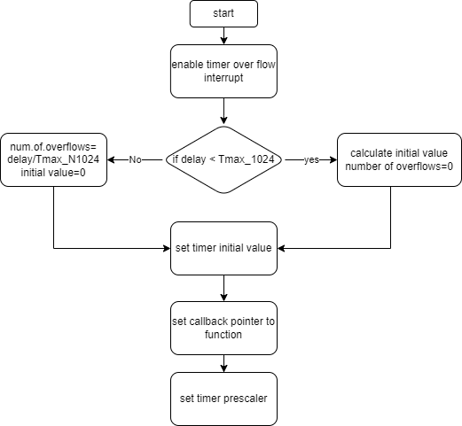
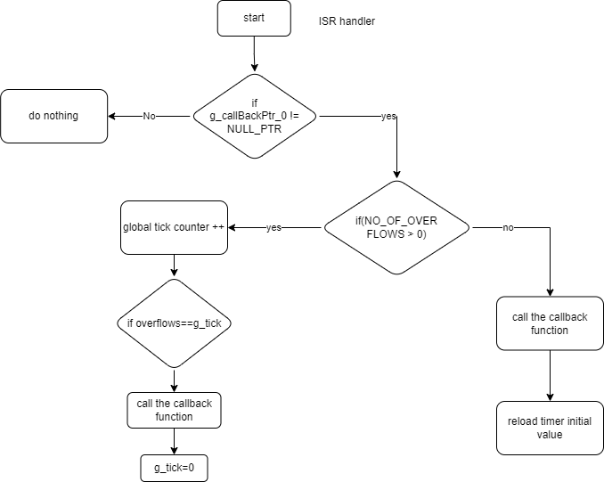
Timer0 APIs flowchart
void Timer0_event(uint16 delay,void(*g_ptr)(void));
ISR (TIMER0_OVF_vect)

Slide 30
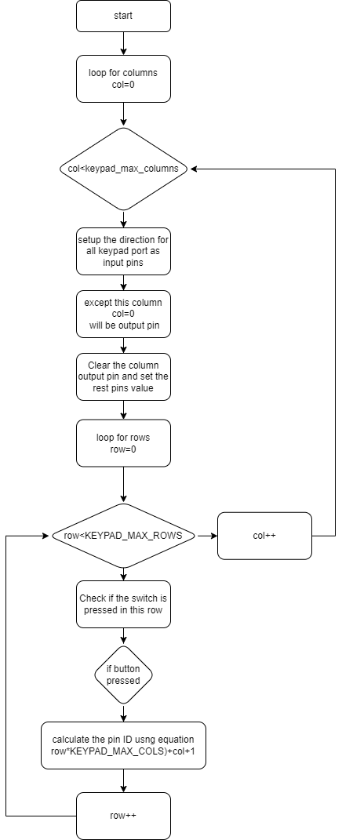
KEYPAD APIs flowchart
uint8 KEYPAD_getPressedKey(void);

Slide 31
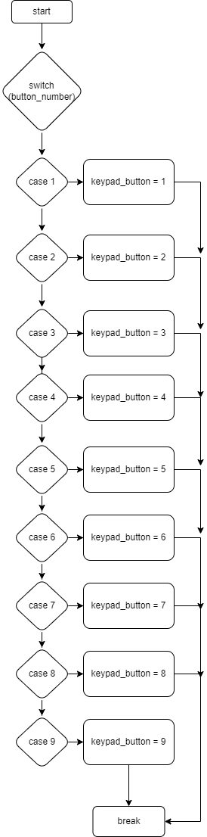
KEYPAD APIs flowchart
static uint8 KEYPAD_3x3_adjustKeyNumber(uint8 button_number);

Slide 32
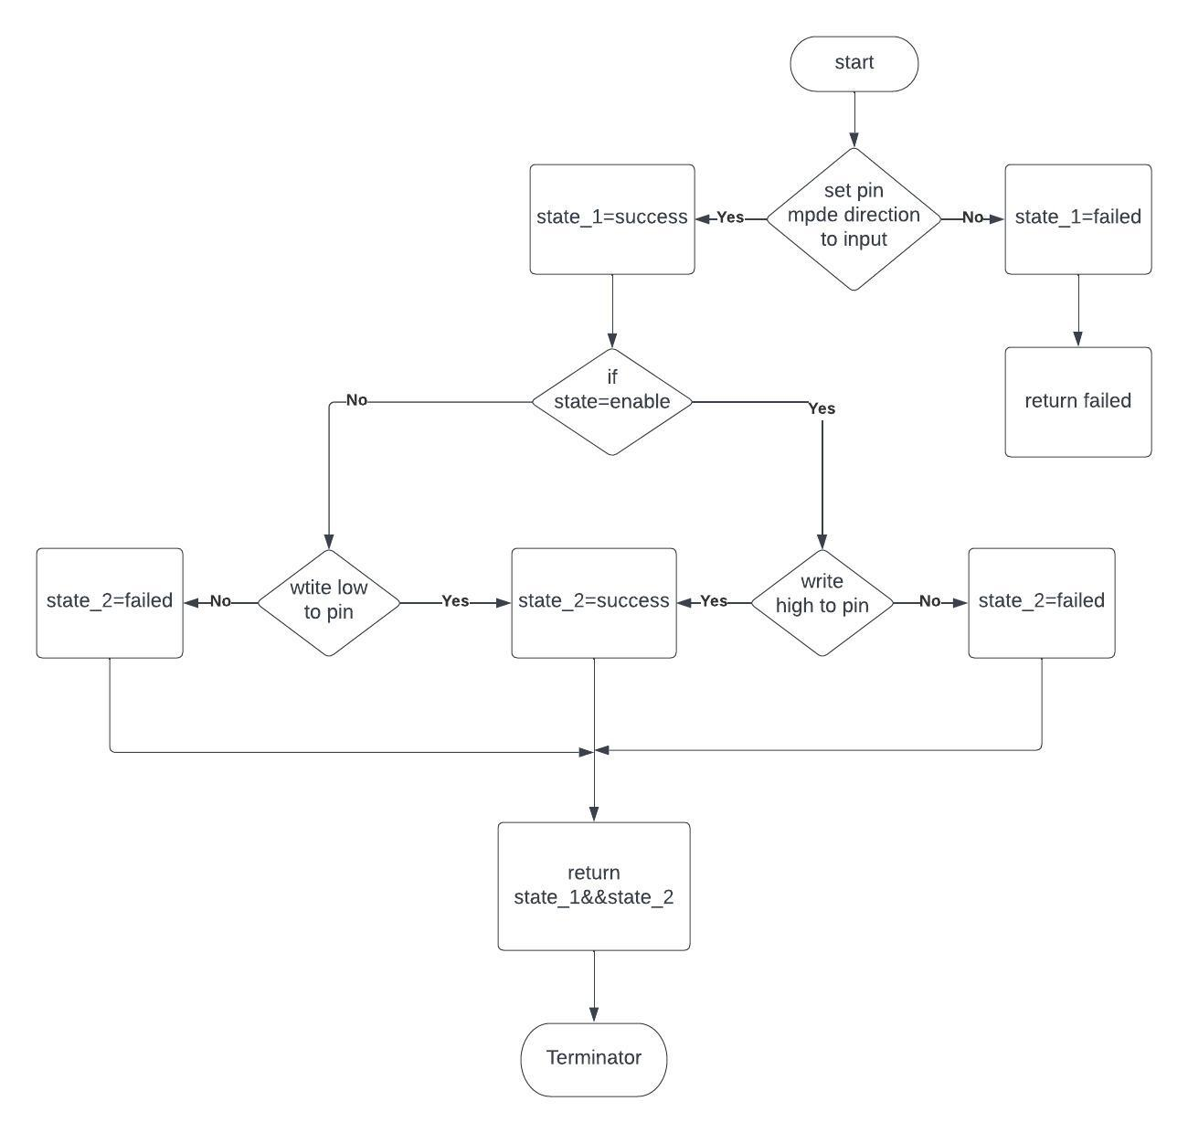
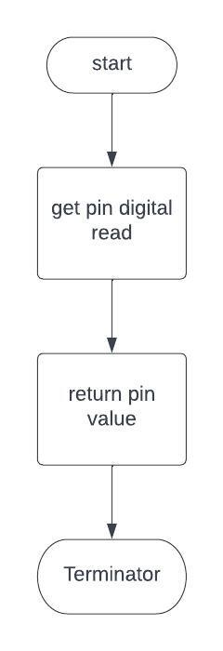
BUTTON APIs flowchart
EN_STATE Button_init(uint8 pin,EN_internal_pullup state);
uint8 Button_Read(uint8 pin)

Slide 33
GPIO pre compiling configuration
/*============= MACRO DEFINITION =============*/
#define PORTA (*((volatile uint8*)0x3B))
#define DDRA (*((volatile uint8*)0x3A))
#define PINA (*((volatile uint8*)0x39))
#define PORTB (*((volatile uint8*)0x38))
#define DDRB (*((volatile uint8*)0x37))
#define PINB (*((volatile uint8*)0x36))
#define PORTC (*((volatile uint8*)0x35))
#define DDRC (*((volatile uint8*)0x34))
#define PINC (*((volatile uint8*)0x33))
#define PORTD (*((volatile uint8*)0x32))
#define DDRD (*((volatile uint8*)0x31))
#define PIND (*((volatile uint8*)0x30))
#define PORTA_ID 0
#define PORTB_ID 1
#define PORTC_ID 2
#define PORTD_ID 3
#define MAX_PORT_ID 4
#define PIN0 0
#define PIN1 1
#define PIN2 2
#define PIN3 3
#define PIN4 4
#define PIN5 5
#define PIN6 6
#define PIN7 7
#define MAX_PIN 8
/*=======PORT ID configuration =======*/
#define PORT_ID 0
#if (PORT_ID == 0)
#define PORT_NAME PORTA_ID
#elif (PORT_ID == 1)
#define PORT_NAME PORTB_ID
#elif (PORT_ID == 2)
#define PORT_NAME PORTC_ID
#elif (PORT_ID == 3)
#define PORT_NAME PORTD_ID
#else
#error "Number of PORT_ID should be equal to 0 or 1 or 2 or 3"
#endif
Description: PORT_NAME configuration ,its value should be 0(port A) or 1(port B) or 2(port C) or 3(port D)

Slide 34
GPIO pre compiling configuration
/*=======PIN ID configuration =======*/
#define PIN_ID 0
#if (PIN_ID == 0)
#define PIN_NUM PIN0
#elif (PIN_ID == 1)
#define PIN_NUM PIN1
#elif (PIN_ID == 2)
#define PIN_NUM PIN2
#elif (PIN_ID == 3)
#define PIN_NUM PIN3
#elif (PIN_ID == 4)
#define PIN_NUM PIN4
#elif (PIN_ID == 5)
#define PIN_NUM PIN5
#elif (PIN_ID == 6)
#define PIN_NUM PIN6
#elif (PIN_ID == 7)
#define PIN_NUM PIN7
#else
#error "Number of PIN_ID should be equal to from 0 to 7"
#endif
Description: PIN_NUMBER configuration ,its value should be 0(port A) or 1(port B) or 2(port C) or 3(port D)
/*============= FUNCTION PROTOTYPE =============*/
void set_direction(void);
void write_pin(void);
Uint8 read_pin(void);
void set_port_direction(void);
void write_port (void);
void read_port (void);

Slide 35
GPIO Linking configuration
/*============= MACRO DEFINITION =============*/
#define PORTA ((volatile char*)0x39)
#define PORTB ((volatile char*)0x36)
#define PORTC ((volatile char*)0x33)
#define PORTD ((volatile char*)0x30)
#define OUTPUT 1
#define INPUT 0
#define HIGH 1
#define LOW 0
#define PIN0 0
#define PIN1 1
#define PIN2 2
#define PIN3 3
#define PIN4 4
#define PIN5 5
#define PIN6 6
#define PIN7 7
/*============= TYPE DEFINITION =============*/
typedef struct portname{
uint8 pinx;
uint8 ddrx;
uint8 portx;
}Sportname;
typedef struct pinconf{
Sportname *PPortx;
uint8 pin_no;
uint8 dir;
uint8 val;
}Spinconf;
typedef struct portconf{
Sportname *PPortx;
uint8 dir;
uint8 val;
}Sportconf;
/*============= FUNCTION PROTOTYPE =============*/
void set_direction(Spinconf *port);
void write_pin(Spinconf *port);
Uint8 read_pin(Spinconf *port);
void set_port_direction(Sportconf *port);
void write_port (Sportconf *port);
void read_port (Sportconf *port);

Slide 36
External Interrupt pre compiling configuration
/*============= MACRO DEFINITION =============*/
#define INT0_ID 0
#define INT1_ID 1
#define INT2_ID 2
#define LOW_LEVEL 0
#define ANY_CHANGE 1
#define FALLING 2
#define RISING 3
/*=======INT_source configuration =======*/
#define INT_source 0
#if (INT_source == 0)
#define INT_ID INT0_ID
#elif (INT_source == 1)
#define INT_ID INT1_ID
#elif (INT_source == 2)
#define INT_ID INT2_ID
#else
#error "Number of INT_source should be equal to 0 or 1 or 2"
#endif
Description: INT_source configuration ,its value should be 0(INT0_ID ) or 1(INT1_ID ) or 2(INT2_ID )
/*=======INT_TRIGGER configuration =======*/
#define INT_TRIGGER 0
#if (INT_TRIGGER== 0)
#define INT_MODE LOW_LEVEL
#elif (INT_TRIGGER== 1)
#define INT_MODE ANY_CHANGE
#elif (INT_TRIGGER== 2)
#define INT_MODE FALLING
#elif (INT_TRIGGER== 3)
#define INT_MODE RISING
#else
#error "Number of INT_TRIGGER should be equal to 0 or 1 or 2 or 3"
#endif
Description: INT_TRIGGER configuration ,its value should be 0( LOW_LEVEL) or 1(ANY_CHANGE ) or 2(FALLING ) or 3(RISING)
/*============= FUNCTION PROTOTYPE =============*/
void INT_init(void);
void INT0_setCallBack(void(*a_ptr)(void));
void INT1_setCallBack(void(*a_ptr)(void));
void INT2_setCallBack(void(*a_ptr)(void));
void INT_Deinit(void);

Slide 37
External Interrupt Linking configuration
/*============= MACRO DEFINITION =============*/
#define INT0_pin 2 //PD2
#define INT1_pin 3 //PD3
#define INT2_pin 3 //PB2
/*============= TYPE DEFINITION =============*/
typedef enum{
EN_INT0,EN_INT1,EN_INT2
}EN_INT_source;
typedef enum{
LOW_LEVEL,ANY_CHANGE,FALLING,RISING
}EN_INT_TRIGGER;
typedef struct{
EN_INT_source source;
EN_INT_TRIGGER trigger;
}ST_INT_Config;
/*============= FUNCTION PROTOTYPE =============*/
void INT_init(ST_INT_Config* Int_config);
void INT0_setCallBack(void(*a_ptr)(void));
void INT1_setCallBack(void(*a_ptr)(void));
void INT2_setCallBack(void(*a_ptr)(void));
void INT_Deinit(ST_INT_Config* Int_config);

